Slide 1

Purge Point Access Tool
Sentinus Team R&D 2019-2020 Aquinas Grammar School

Slide 2

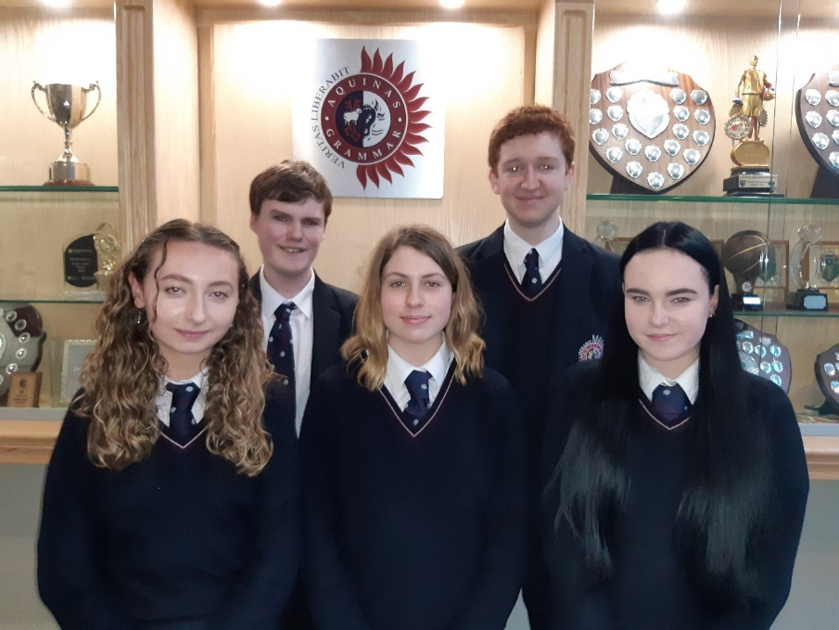
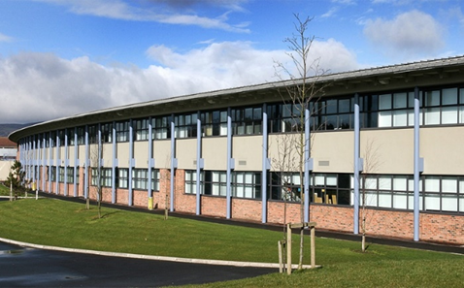
Introduction -Our Team-
Aquinas has founded a strong focus on academia, particularly STEM based subjects, and continues to promote them to students as an to opportunity to develop their problem solving and mathematical skills, as well as their interests in science and technology whilst also promoting interaction with fellow students through projects such as Sentinus .
-From left to right-
Laoise Kielty
Andrew Farquharson
Olivia Morrow
Joseph McSorley
Georgia Montgomery

Slide 3
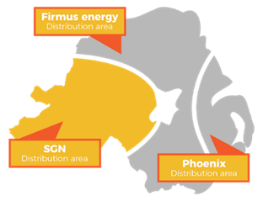

Introduction -Phoenix Natural Gas-
Phoenix Natural Gas is the largest gas distribution business in Northern Ireland, being the owner and operator of the license for the distribution network in the Greater Belfast area. It was founded in 1996.
Our link engineer from Phoenix Natural Gas explained the use or purge points in their pipe systems. Purge points are pipe nipples installed at strategic locations in the piping system for the purpose of introducing or removing nitrogen and natural gas at various stages of the process.
Phoenix Gas uses purge valves to let the air out of their gas pipes, these can be strenuous to open and require multiple tools.

Slide 4
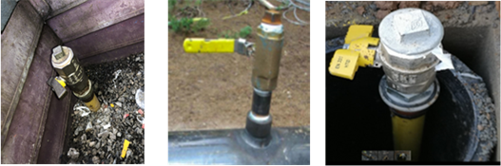
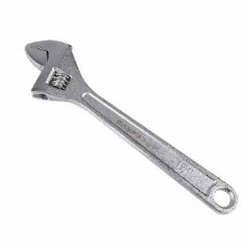
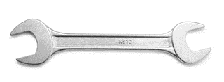
Aims & Objectives -The problem-
We must design a mechanism which can be used to loosen and release the uppermost nut in a one-inch ball valve which is used as a purge point in the pipe network. This valve is situated underground in an inspection chamber [20 -30cm below ground] which has a variety of accessibility issues.
Purge Point
Nut that must be removed with mechanism
Connection to pipe network, usually situated underground.
Current Solution
Two wrenches are currently used to unlock the purge value
We need to create an easy to use tool which will replace their current mechanism and which requires minimal effort to use by the operator.

Slide 5
Research & Development -Site Visit & Initial research-
On the 8th of November we visited Phoenix Gas headquarters, where we were given an incite into the work of the corporation and a personal look at their current solutions to the purge point problem.
We went to a worksite at Ormeau Park to see the purge point in an everyday scenario, this helped the team envision and help build on our possible solutions more clearly as we could see the reality of the accessibility issues.

Slide 6
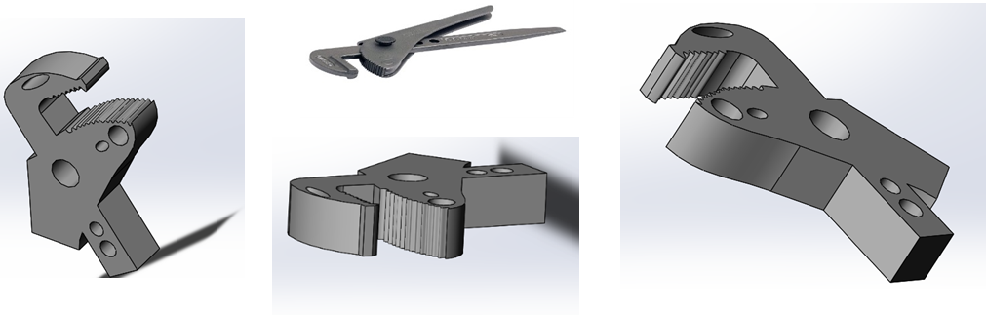
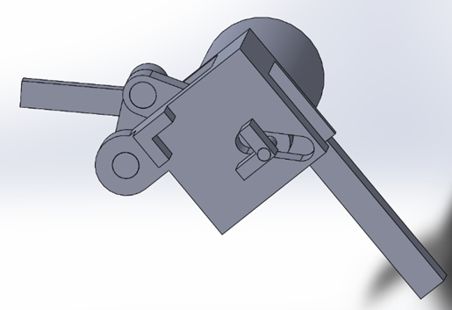
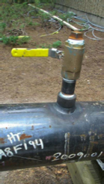
Research & Development -Initial Ideas-
We next thought about the nut that needed to be removed. The part would be used to secure the cap of the purge valve and adjust the size of the grip so that it could be used on different sizes of caps.
Our first thoughts involved two separate parts. The first part involves a long metal pipe (at least 20-30cm long), with an adjustable wrench at the bottom. The wrench can be adjusted to suit the different sizes of purge point used. Ideally, the wrench could be tightened to provide a strong grip to prevent the purge point from possibly moving during usage.
The parts shown was an initial idea to secure the bottom part of the valve whilst the top is being removed, The arm will be connected to this part at a perpendicular angle. The head of the part is adjustable as the valve comes in different sizes.

Slide 7
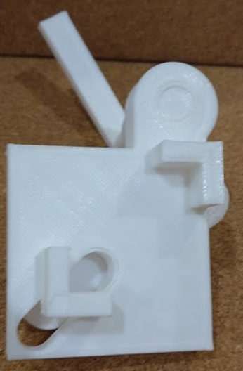
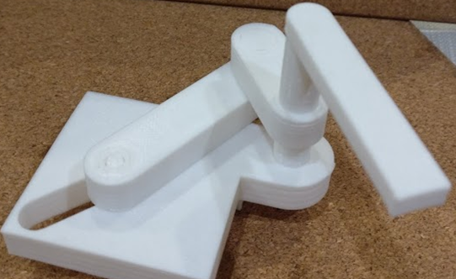
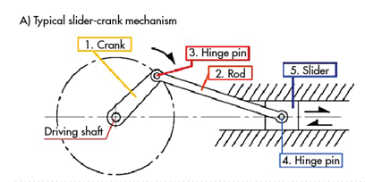
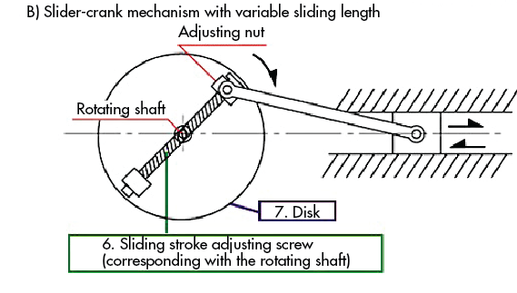
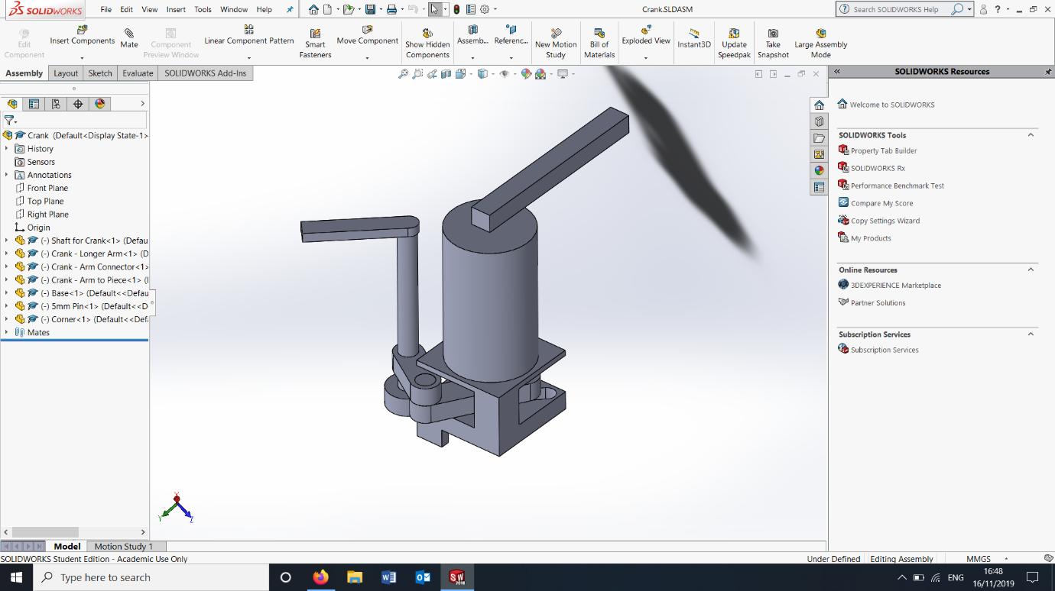
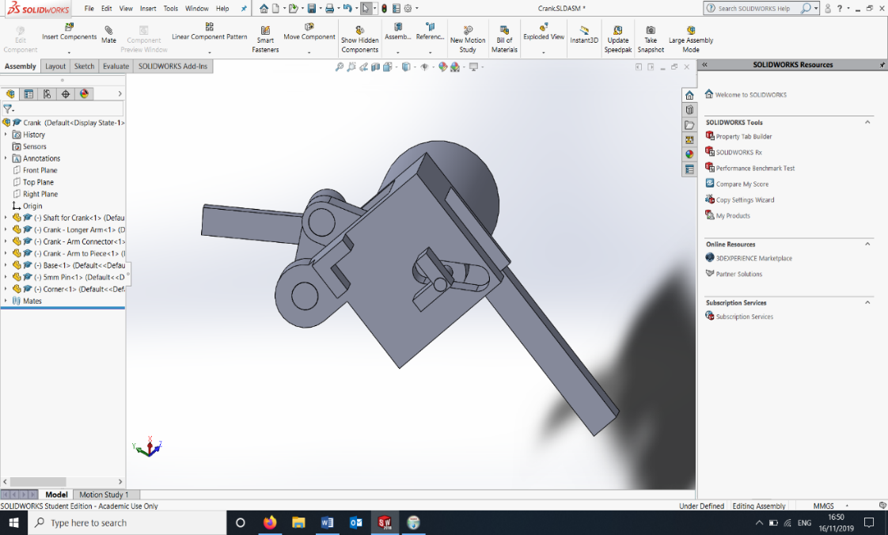
Research & Development -Initial Ideas-
We decided to develop the cap mechanism further.
This diagram shows a mechanism on how to convert rotational motion to linear motion and this design will be the basis of this potential design
This is a 3D printed prototype of the adjustable cap mechanism, this proves that the mechanism works and is a feasible design.
When the arm is rotated the crank arm moves shifting one half of the clamp either closer or further away from the other side to allow different sizes of caps to fit.
Once this is done the entire part can be rotated to allow the cap to be taken off through the use of the larger handle.

Slide 8
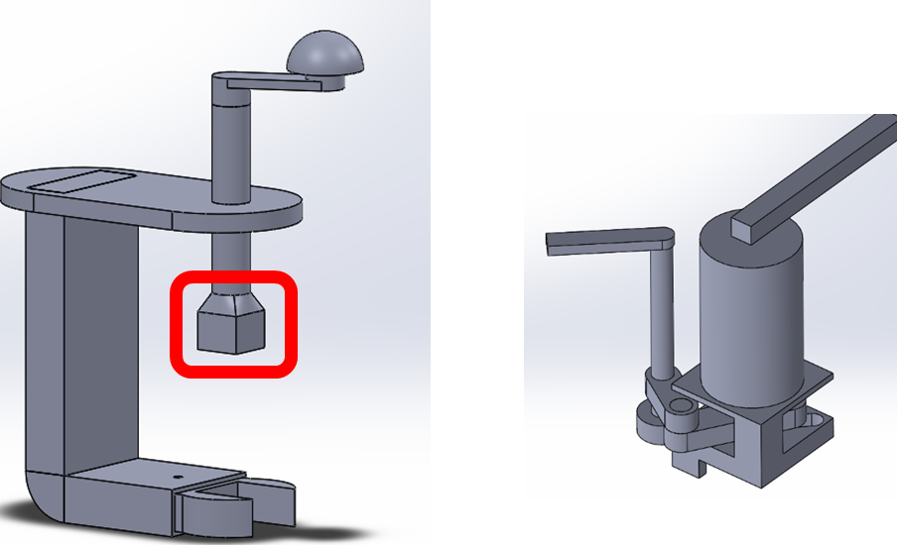
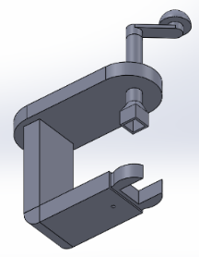
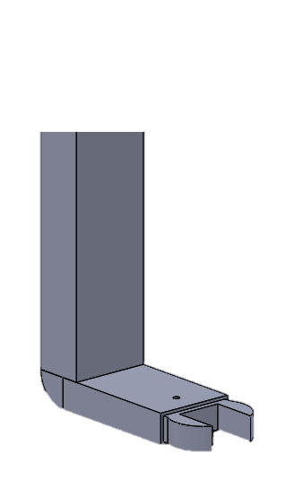
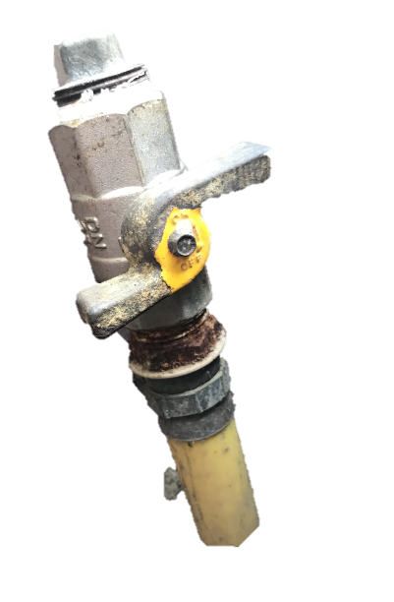
Research & Development -Agreed Solution-
We agreed to develop two different designs in tandem. The first part is based off an initial solution which would act as a simple solution that would accomplish our goal however, it would lack an adjustable mechanism. The second part, which would be developed as a modification to this design, would allow different sizes of purge valve heads to be opened. This would be designed of the back of potential design number three.
Part 2
Part 1

Slide 9
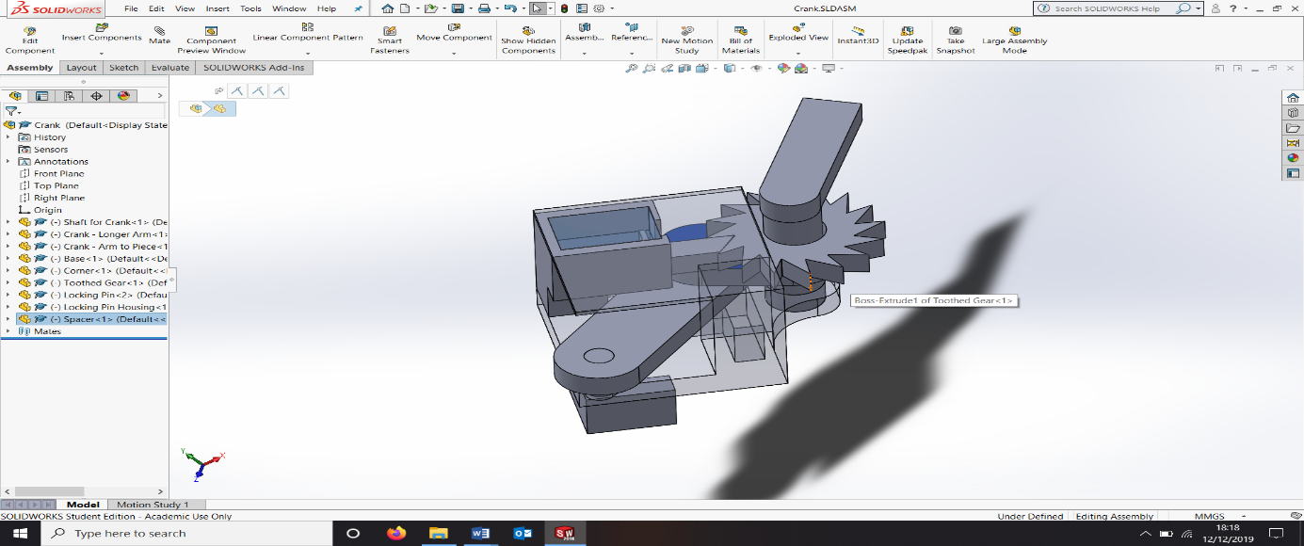
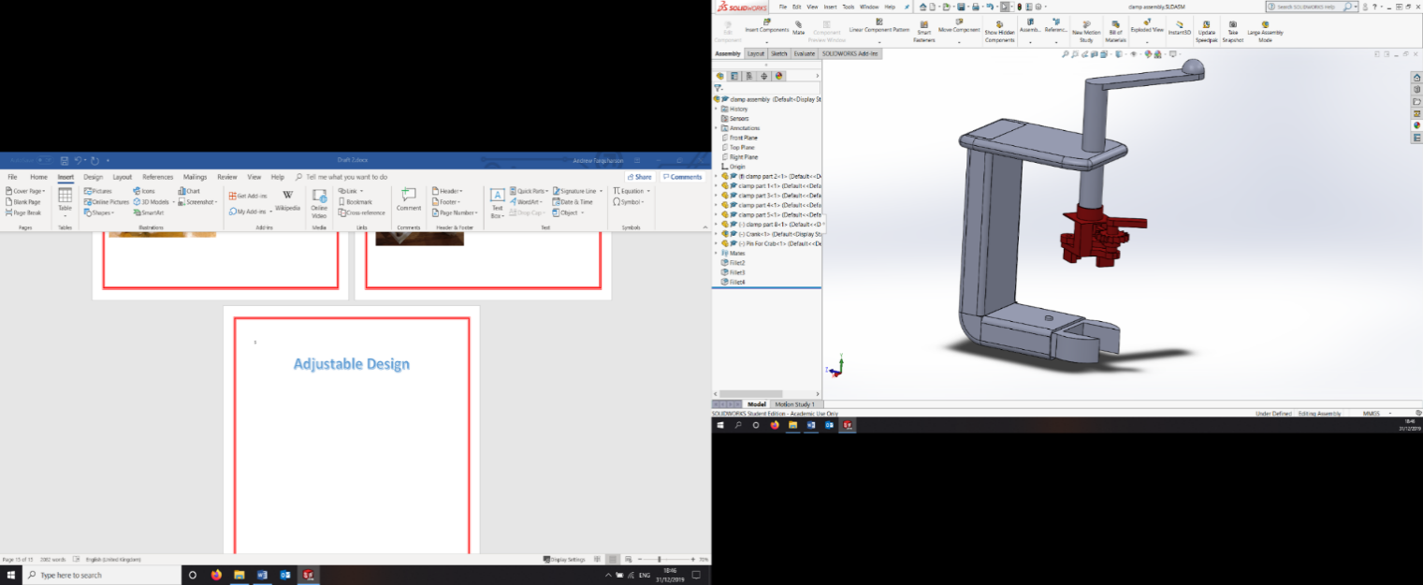
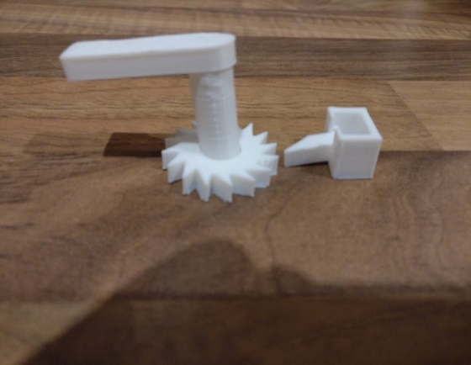
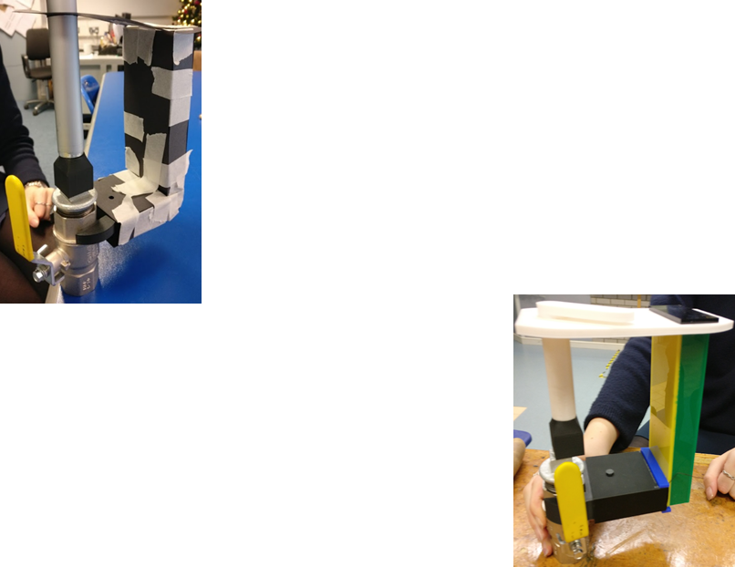
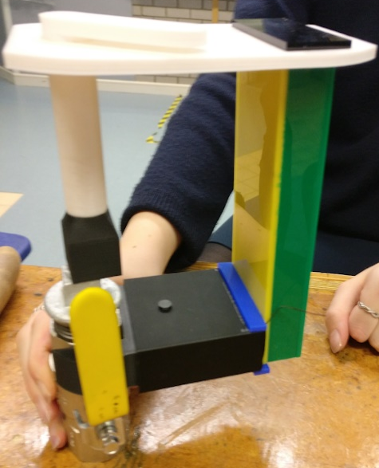
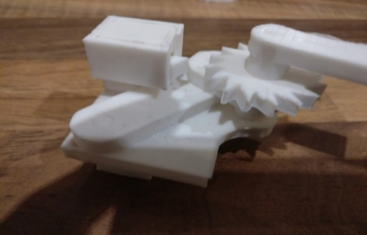
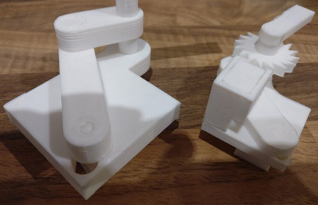
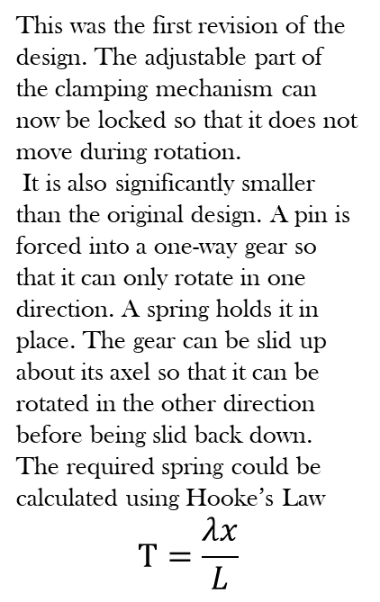
Research & Development -Agreed Solution-
The Solidworks model shown to the left is that of our simple solution integrated with our adjustable locking mechanism. Part of the lid of the clamp has been extruded outwards to provide a good surface for the handle to mount to. Some of the edges of the design have also been filleted to improve the aesthetic quality of the product.
This was the first revision of the design. The adjustable part of the clamping mechanism can now be locked so that it does not move during rotation.
It is also significantly smaller than the original design. A pin is forced into a one-way gear so that it can only rotate in one direction. A spring holds it in place. The gear can be slid up about its axel so that it can be rotated in the other direction before being slid back down.
The required spring could be calculated using Hooke’s Law
$$T=\frac{λx}{L}$$
Prototypes

Slide 10
Research & Development -Final Product -
Due to Covid-19 our final product is locked in school and so we cannot get to it to get an image however it does work fully.
We apologise for this inconvenience.

Slide 11
Thank You For Your Time!

